Slide 1
Customer Behavior
Analysis
Introduction

Slide 2
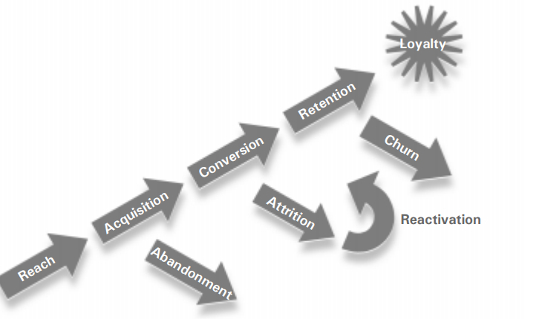
Customer Life Cycle
Reach
Acquisition
Conversion
Retention
Loyalty

Slide 3
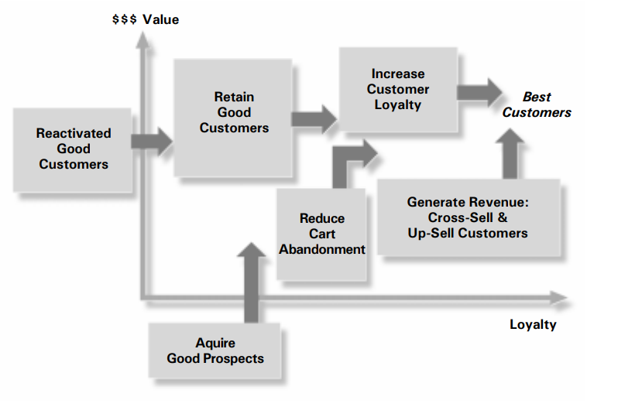
Customer Lifetime Value Optimization

Slide 4
Life Cycle Pipeline
Prospect
Suspect
Qualified Prospect
Closing Prospect
New Customer
Unhappy Customer
Referring Customer
Company Advocate

Slide 5
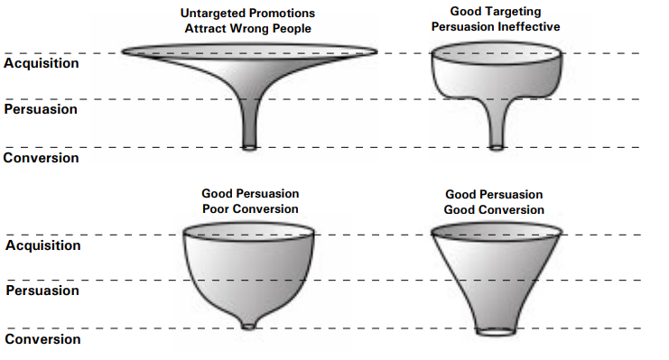
Customer Life Cycle Funnel

Slide 6
Source of Customer Data
In-Store and Online Sales Data
Survey Data
Customer Service Data
Sales Department Data
Advertising Platforms
Web Analytics
Marketing Automation Platforms
Loyalty Data
Mobile App Data
Wearables and the Internet of Things

